Slide 1
Ratings Prediction

Slide 2
Problem Statement-
Data Collection-
Scrape at least 20000 reviews of different laptops, Phones, Headphones, smart watches, Professional Cameras, Printers, Monitors, Home theater, Router from different e-commerce websites using webscraping.
Model Building –
After collecting the data, you need to build a machine learning model that will predict the rating of a product from its review

Slide 3
Problem Understanding-
We have a client who has a website where people write different reviews for technical products. Now they are adding a new feature to their website i.e. The reviewer will have to add stars(rating) as well with the review. The rating is out 5 stars and it only has 5 options available 1 star, 2 stars, 3 stars, 4 stars, 5 stars. Now they want to predict ratings for the reviews which were written in the past and they don’t have a rating. So, we have to build an application which can predict the rating by seeing the review.

Slide 4
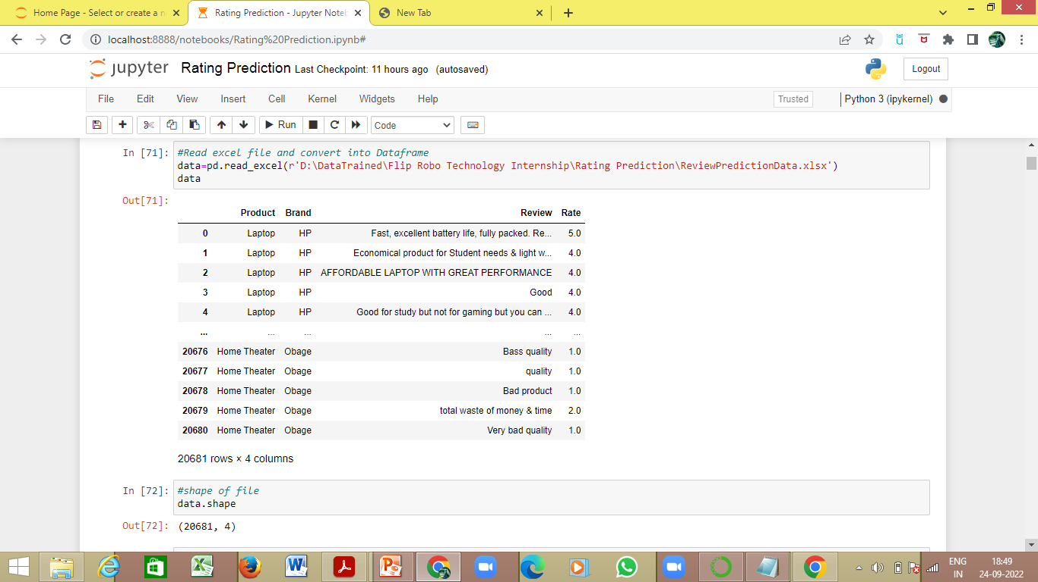
Data Collection
The data is scraped from 2 websites-
amazon.in
flipkart.com
20681 reviews are scraped from both the websites.

Slide 5
Model Building
EDA Steps and Visualization

Slide 6
The web scraped data is saved onto an excel sheet
The excel datasheet is extracted and saved in a dataframe
The shape of the dataframe is checked-
There are 20681 rows and 4 columns
The columns are as follows-
Product
Brand
Review
Rate

Slide 7
The data type of each column is-
Product - object
Brand - object
Review - object
Rate - float64
The null values are checked. The whitespaces, and dashes (‘—’) are replaced by null values-
Product - 0
Brand - 0
Review - 5
Rate - 0
As 5 rows have null values, it is safe to delete these rows
The shape of the dataframe now is-
There are 20676 rows and 4 columns

Slide 8
The data visualization, value counts and encoding object data for each column

Slide 9
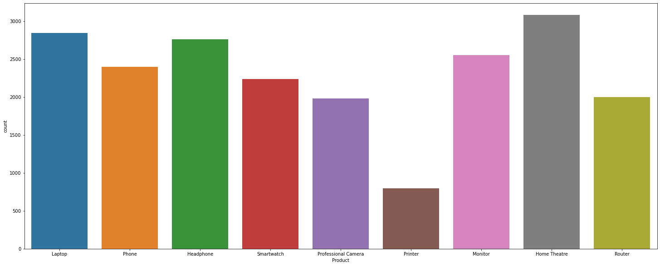
Product
3085 are headphone reviews
2848 are laptop reviews
2557 are monitor reviews
2399 are phone reviews
2239 are smartwatch reviews
1999 are home theater reviews
1999 are router reviews
1985 are professional camera reviews
800 are printer reviews
Encoding object data in numeric using Label Encoder

Slide 10
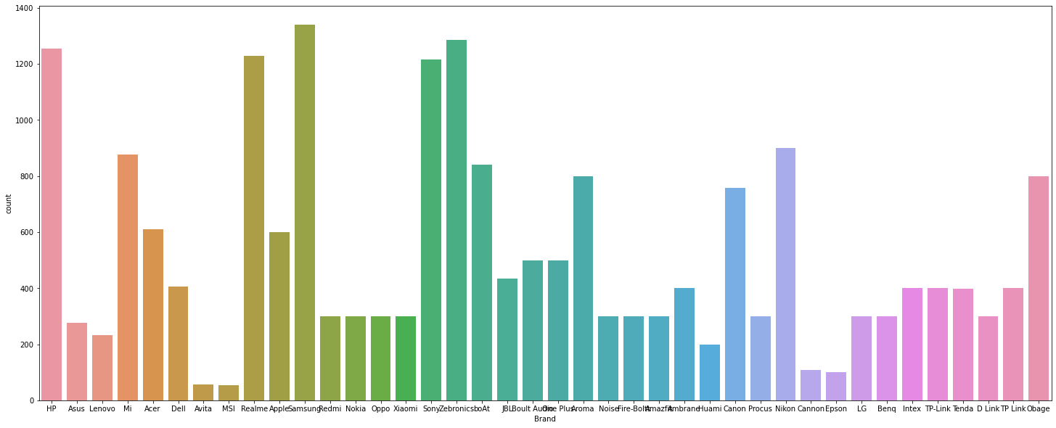
Brand
Samsung -1340
Zebronics -1286
HP -1254
Realme -1230
Sony -1217
Nikon -900
Mi -878
boAt- 840
Aroma -800
Obage- 800
Canon -759
Acer -610
Apple -600
Boult Audio- 500
One Plus -500
JBL- 434
Dell -405
Ambrane -400
TP Link -400
TP-Link -400
Intex -400
Tenda -399
Procus -300
D Link -300
Benq -300
LG -300
Nokia -300
Redmi -300
Amazfit -300
Fire-Boltt -300
Oppo -300
Xiaomi -300
Noise -299
Asus -277
Lenovo -232
Huami -200
Cannon -107
Epson- 100
Avita -56
MSI -53
Encoding object data in numeric using Label Encoder

Slide 11
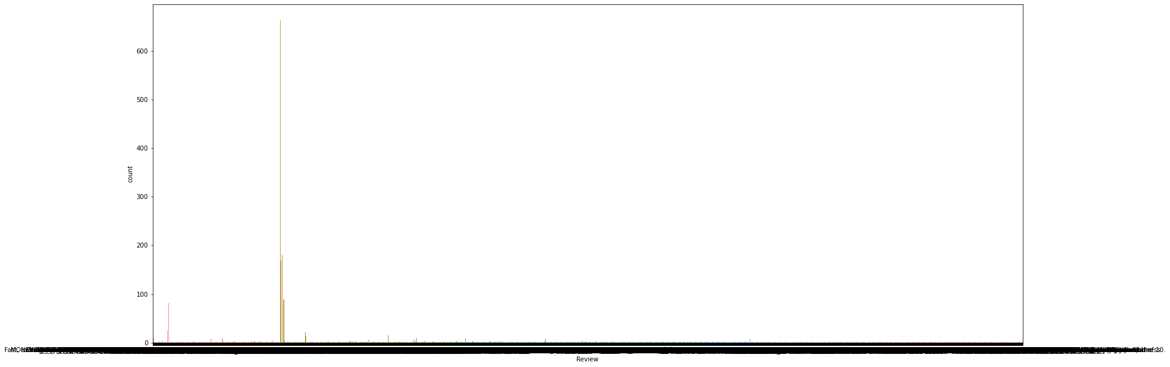
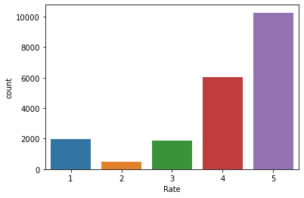
Review
Rate
Majority of the reviews were “Wonderful’, ‘Good’, ‘Excellent’.
10270 products have 5 star rating
6058 products have 4 star rating
1963 products have 1 star rating
1891 products have 3 star rating
494 products have 2 stars rating
Encoding object data in numeric using Label Encoder
Encoding object data in numeric using Label Encoder

Slide 12
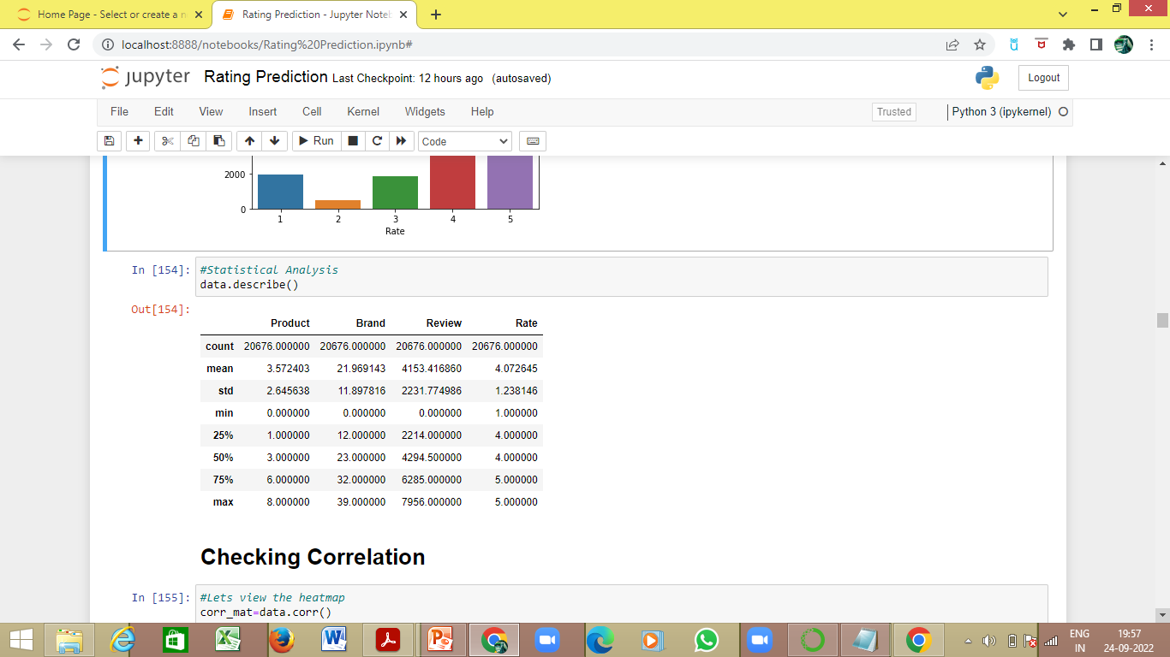
Statistical analysis using describe method-

Slide 13
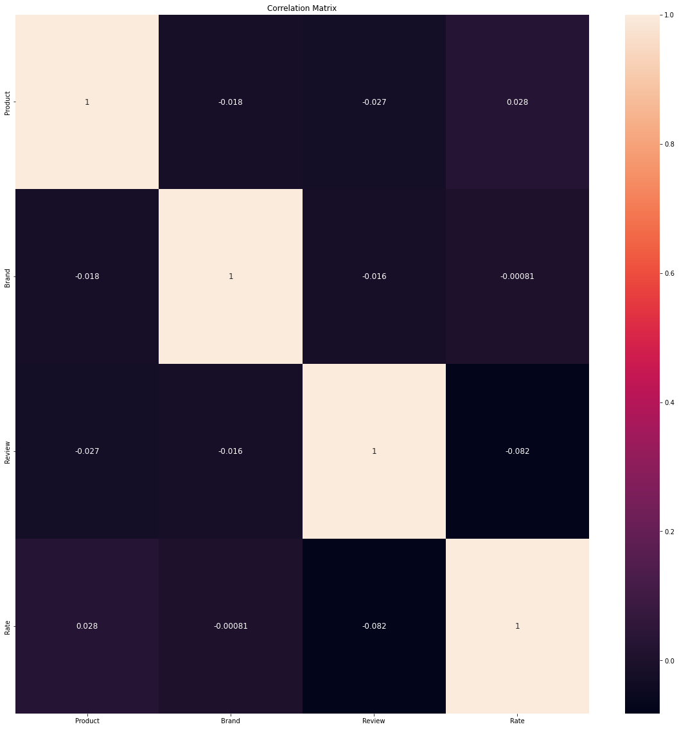
The Correlation Matrix using heatmap
Correlation between the columns and the label ‘Rate’ using corr method-
Product: 0.027645
Brand: -0.000810
Review: -0.081948
Product is 2.72% positively correlated to ‘Rate’
Review is 8.1% negatively correlated to ‘Rate’

Slide 14
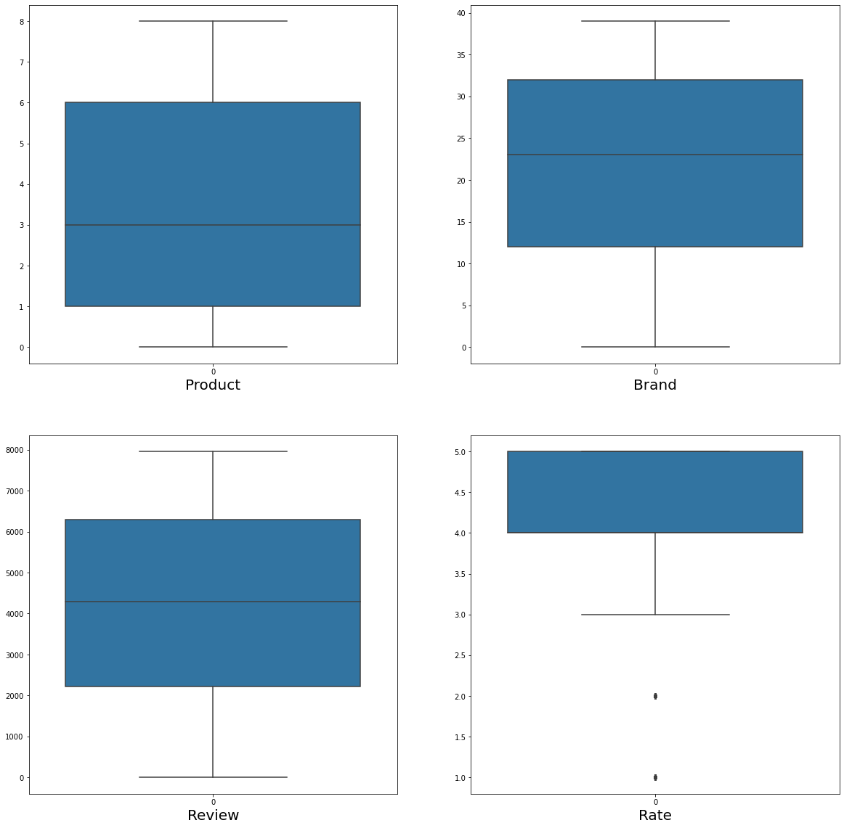
Visualizing outliers using boxplot method-

Slide 15
Removing outliers using zscore method-
On removing the outliers the data loss is 0%, which is acceptable, hence outliers are removed
The dataset is divided into x(features) and y (label)-
The x contains all the features other than the label ‘Rate’
The y contains only the label ‘Rate’

Slide 16
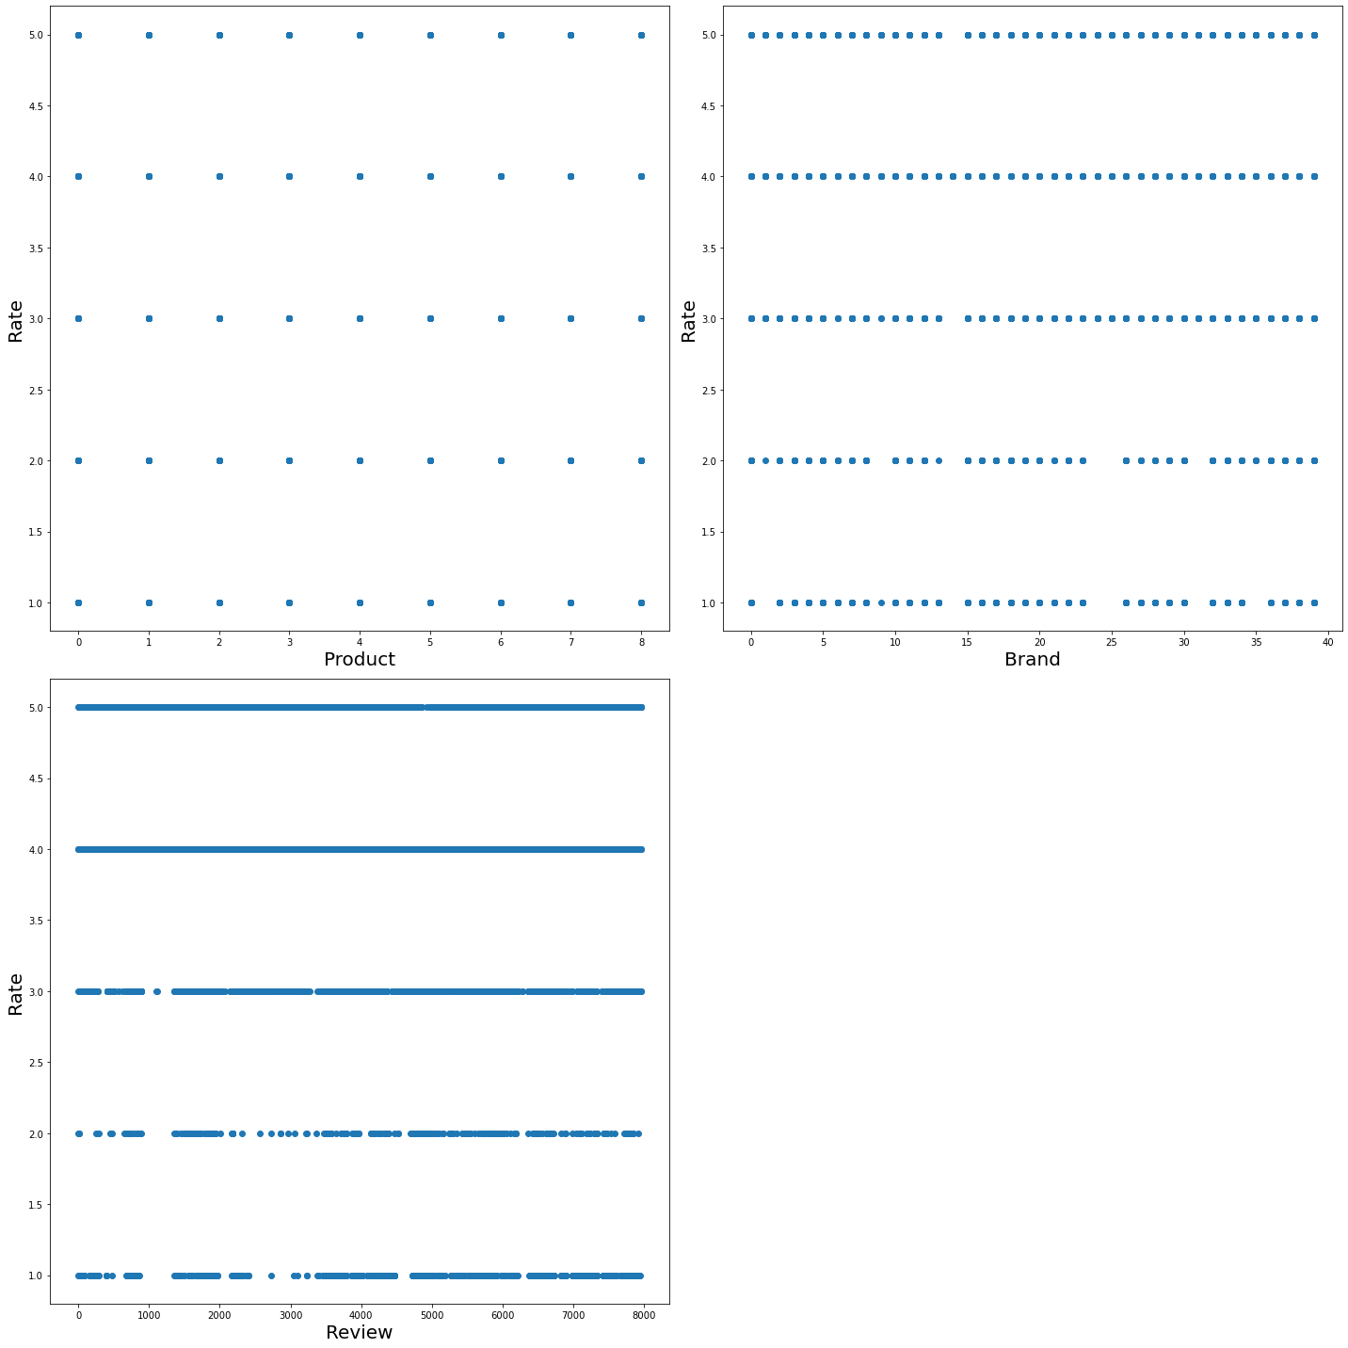
Visualizing relationship between features and label-

Slide 17
The skewness observed in graphical analysis was confirmed by using the skew method-
Product: 0.302151
Review: -0.047409
Brand: -0.313749
This skewness was removed using the power transformer
The x(features) were scaled using the Standard Scaler
The dataset was divided into train and test set using train test split and the best random state was found to be 3

Slide 18
The train and test data were applied on different models as follows

Slide 19
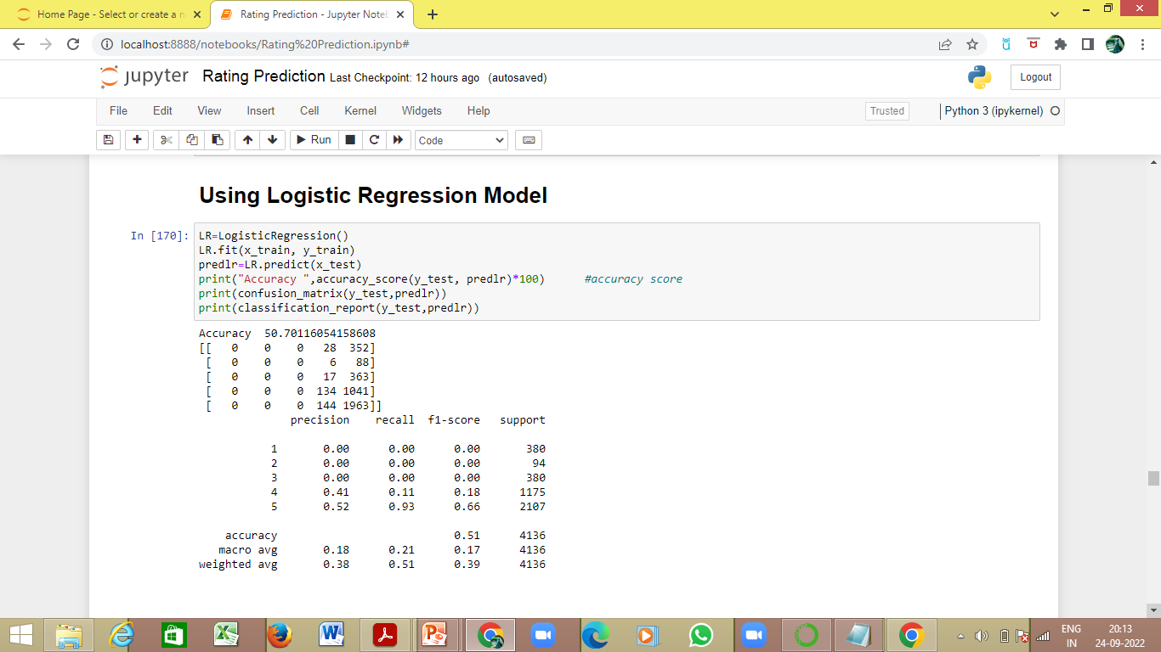
Logistic Regression Model
The Accuracy for target test and pred_test(data predicted on features_test) is 50.70%
The Confusion Matrix and Classification Report for target test and pred_test(data predicted on features_test) is –

Slide 20
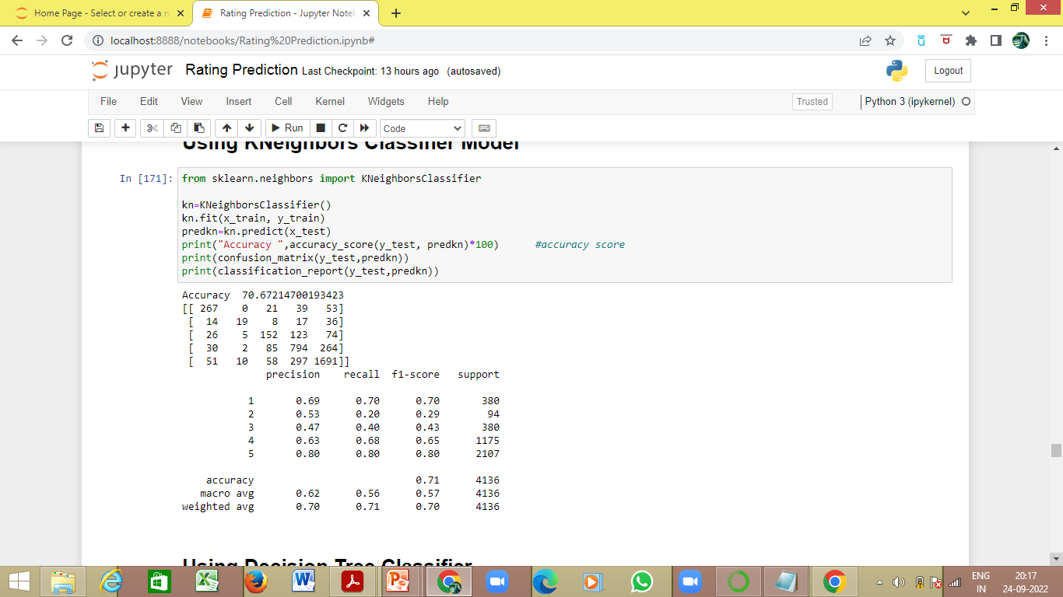
KNeighbors Classifier Model
The Accuracy for target test and pred_test(data predicted on features_test) is 70.67%
The Confusion Matrix and Classification Report for target test and pred_test(data predicted on features_test) is –

Slide 21
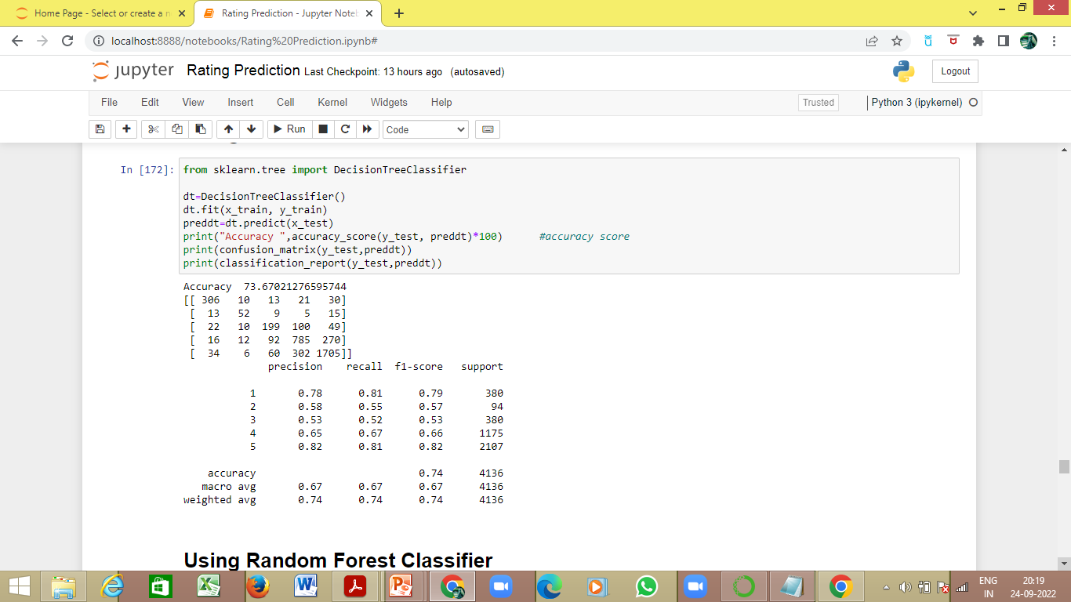
Decision Tree Classifier
The Accuracy for target test and pred_test(data predicted on features_test) is 73.67%
The Confusion Matrix and Classification Report for target test and pred_test(data predicted on features_test) is –

Slide 22
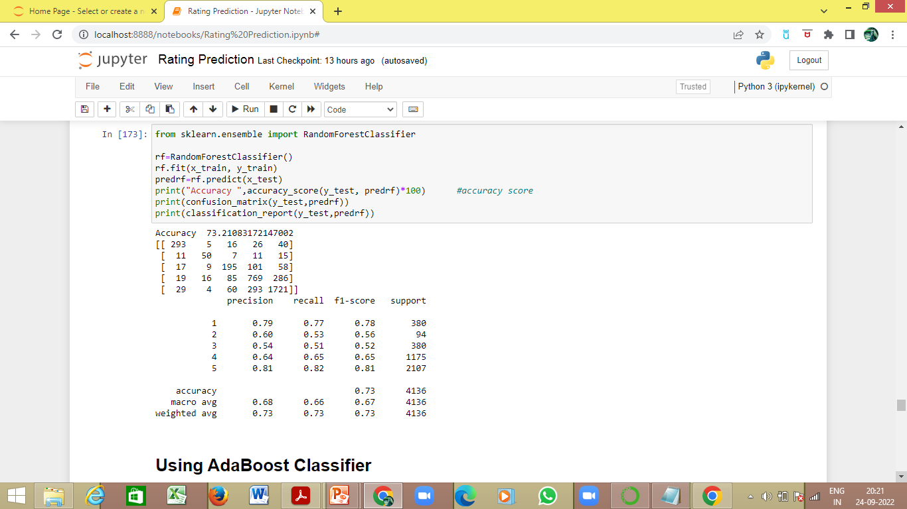
Random Forest Classifier
The Accuracy for target test and pred_test(data predicted on features_test) is 73.21%
The Confusion Matrix and Classification Report for target test and pred_test(data predicted on features_test) is –

Slide 23
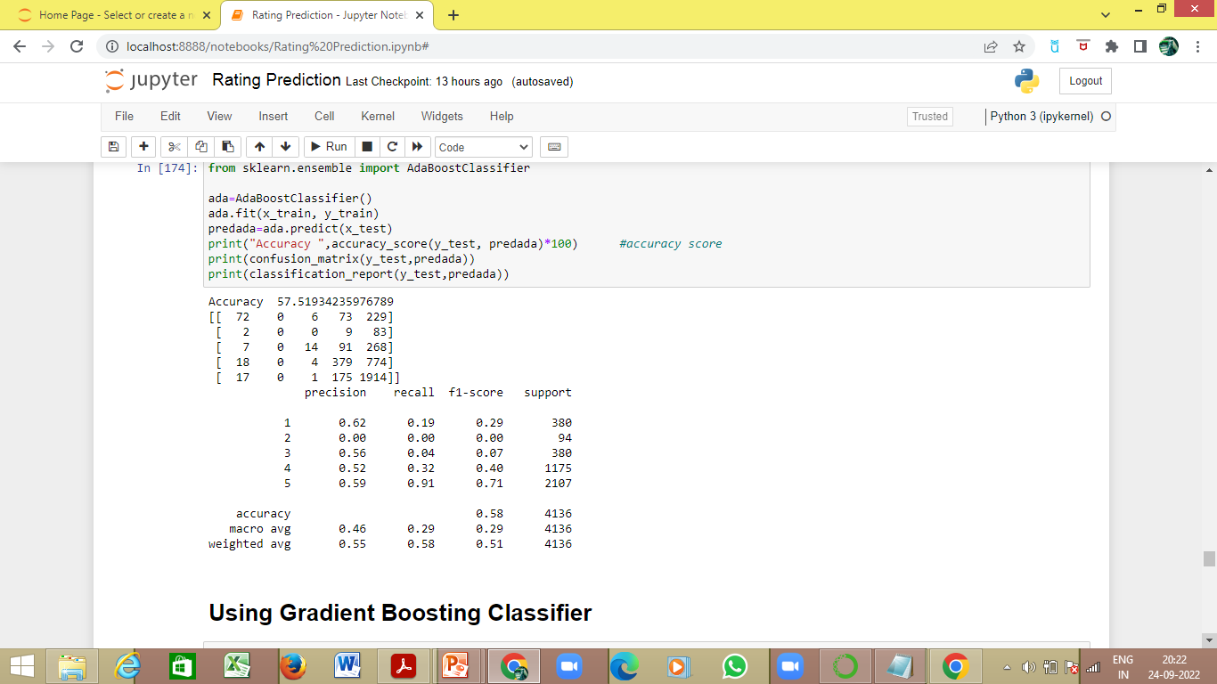
AdaBoost Classifier
The Accuracy for target test and pred_test(data predicted on features_test) is 57.52%
The Confusion Matrix and Classification Report for target test and pred_test(data predicted on features_test) is –

Slide 24
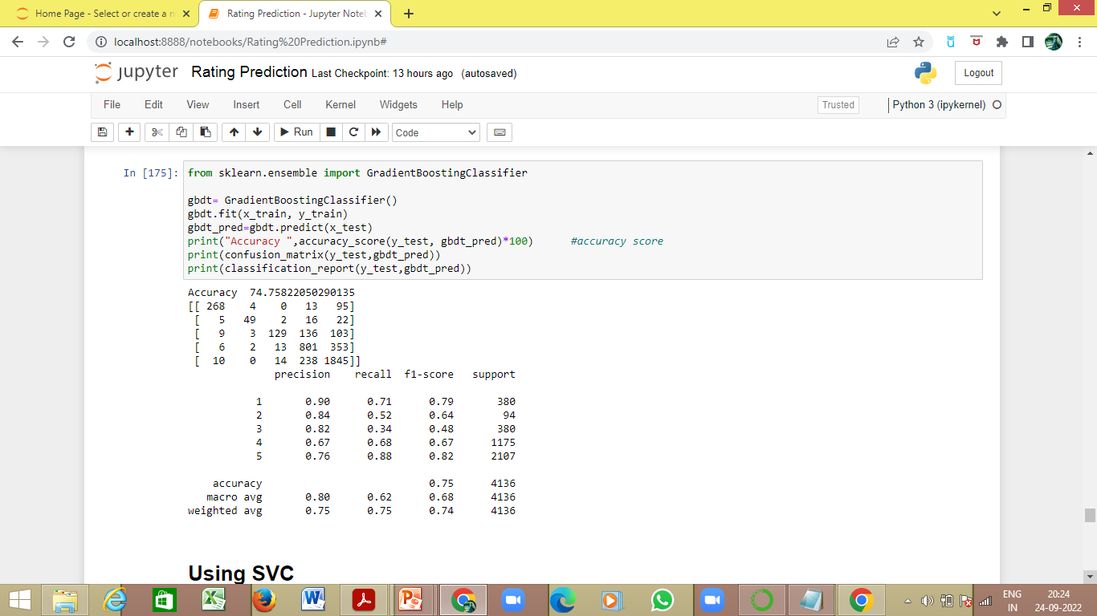
Gradient Boosting Classifier
The Accuracy for target test and pred_test(data predicted on features_test) is 74.76%
The Confusion Matrix and Classification Report for target test and pred_test(data predicted on features_test) is –

Slide 25
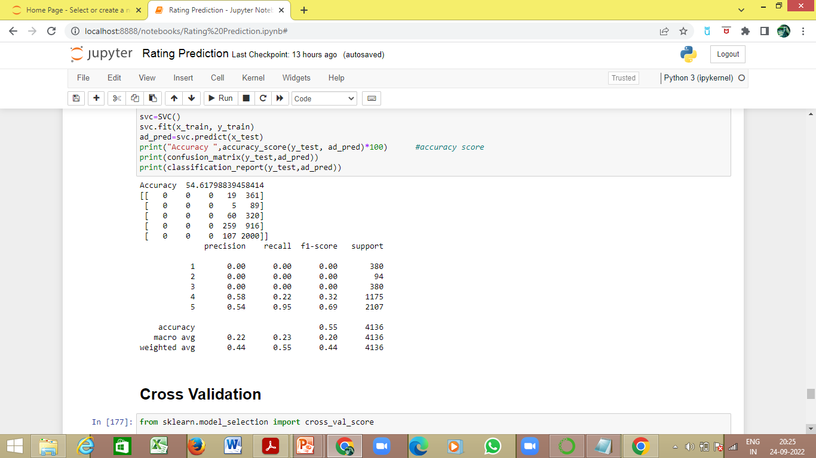
SVC
The Accuracy for target test and pred_test(data predicted on features_test) is 54.62%
The Confusion Matrix and Classification Report for target test and pred_test(data predicted on features_test) is –

Slide 26
Cross Validation
Model | Cross Validation Score
Logistic Regression | 0.4863
KNeighbor Classifier | 0.6687
Decision Tree Classifier | 0.5379
Random Forest Classifier | 0.3148
Ada Boost Classifier | 0.4732
Gradient Boost Classifier | 0.5855
SVC | 0.4967
KNeighbor Classifier is performing better, hence it is carried forward

Slide 27
Hyperparameter tuned KNeighborsClassifier Model
KNeighborsClassifier Model is hyperparameter tuned using GridSearchCV
The best parameters for algorithm is found as follows-
algorithm: brute
Applying the above found best parameters on KNeighborsClassifier Model, the following was obtained-
The Accuracy for target test and pred_test(data predicted on features_test) is 70.55%
Final Accuracy is 70.55% which depicts that our model is working well

